Slide 1
A Practical Guide to Big Data

Slide 2




About Me
@kthejoker
khale@infusion.com
Designed first database at 8 to
record the statistics of an imaginary
baseball game he played in his backyard.
BI guy for 10 years, primarily in commodity trading and higher education
You should totally hire Infusion
First presentation in quite a while, so pardon the dust
Notes:
This is like the opposite of a humblebrag,

Slide 3
Agenda
Obligatory Big Data 101
Preflight Checklist
A Practical Approach
Demo
Q&A

Slide 4
Big Data: Not Just Data (..I Know, Right?)
“Big Data” is an industry term for both the data itself and the technologies, methods, and applications used to analyze it.

Slide 5
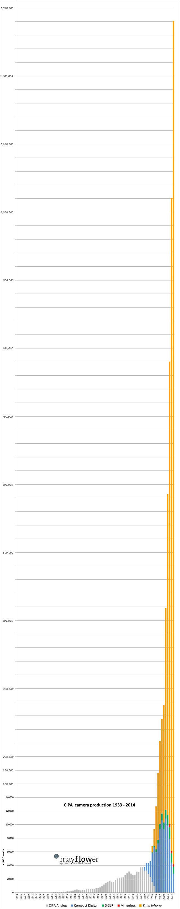
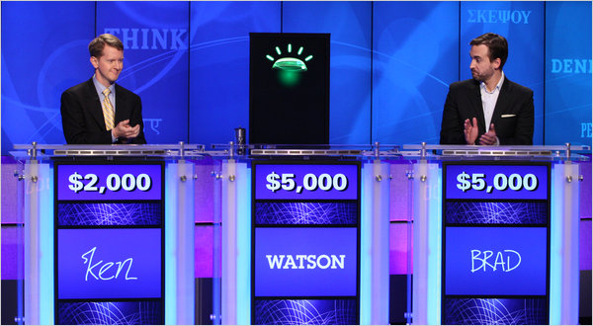

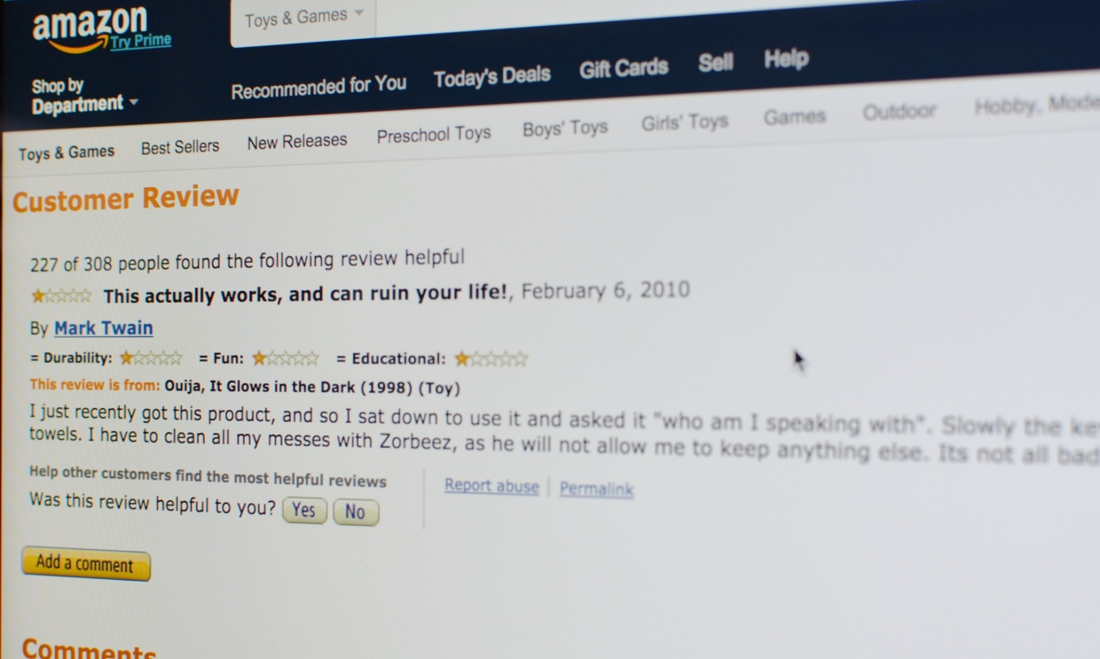
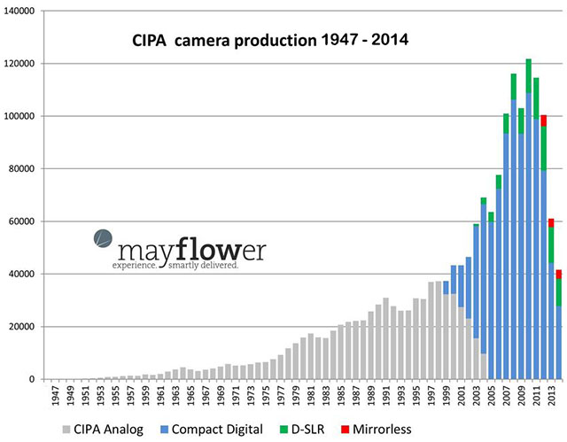
Big Data In The News
Notes:
Brad Rutter and Watson
Amazon is going to crack down on user reviews using machine learning and some big data
BGI, the world’s largest genome mapping company, cranking through an average of 50 human genomes a week, and generating 6 terabytes of data a day. A decade ago, The Human Genome project spent 4 years and $3 billion to sequence one genome. BGI predicts sequencing will drop to $200 to $300 over the next 5 years.
More pictures taken last week than the entire 1970s. (Take a picture of the group.) Just doing my part.

Slide 6
Common Use Cases
CRM
Predictive analytics
Clinical data
Web traffic analysis
Internet of Things
Notes:
Predictive analytics, so things like risk assessment, fraud detection, supply and demand prediction, and of course behavioral analysis, like recommendation engines and tailored advertising.
Collecting a ton of Iot data these days, between IPv6, mobile devices, RFID tags, smart meters, PI and now SCADA, etc.

Slide 7
The Four Vs
Volume The “Reduce” in MapReduce YAGNI Storage costs | Variety Interpretation Estimation “Show your notes”
Velocity Sampling Aggregation Time to act | Veracity Dirty data “Pardon me, your bias is showing” Reliability
Notes:
Volume –
Reducing dimensionality is critical – scoring and quantification. (Sentiment analysis is a good one – take a 5 paragraph review and condense it to a -1 to 1 range.)
YAGNI, what’s that? You Ain’t Gonna Need It.
APIs and feeds versus files and local caching.
Storage Options – Hadoop and similar Big Data technologies use distributed file systems and commodity hardware; compared to some EDW vendors, your cost savings can be tremendous.
Variety
Not all objective numbers
Sentiment analysis, things like sarcasm / ambiguity
Image / video data, artifacting, estimating,
Diagnosis/symptoms, recommendations, basket analysis, no clear cut causality
Veracity
Unstructured, inconsistent,
Velocity
Analysis windows, important to consider recency bias
Back to our firehose analogy
Veracity
Reliability – are these strings of zero readings on my PI meter signs of a pipe failure, network failure, a bad reader, etc.

Slide 8
Comparing to Traditional BI
 | Traditional BI | Big Data
Volume | GB / TB | PB
Velocity | “Half an hourly” | Near real-time
Variety | None – Metadata clearly defined | Infinite – Metadata not defined
Veracity | Certainty | Probability

Slide 9
Big Data Preflight Checklist
Culture
Does my company have an evidence based culture?
Value Proposition
Is the data worth analyzing?
Technical
How many of the four Vs are you checking off?
Have I integrated our existing enterprise data into every day use?
Is the accuracy / speed tradeoff worth foregoing data validation / cleansing?
Am I okay with probabilities over certainties?
Do I need to be able to recreate my findings ?
Is time to decision a critical success factor in the analysis I need to perform?
Is my data source providing repetitive, stable data that is a good fit for parallelism / threading ?
Notes:
If not, ground the flight.
BI spectrum of comfort. I once compared an enterprise data warehouse project to souping up your car, and the guy said, “What car, we’ve got a wheelchair.”

Slide 10
A Practical Guide to Big Data
Things To Do | Things Not To Do | Things To Consider
Project Management 101 Through, not around Focus on the decision Dust off your stat books Think of results as another input into decisionmaking | “Let’s take it all” Data != Insight Ignore “opportunity to act” as a factor Black box architecture | Privacy concerns Provenance People
Notes:
Hey that’s the name of the talk!
Things To Do
Project Management 101, so these are the things you should do on every project, not just big data projects. Here especially we should be looking at projects as experiments where we manage risk through limiting scope, having frequent communication about objectives, and really trying to capture business objectives.
Through not around – use your existing information architecture and knowledge systems. Leverage tools that your developers know (languages, IDEs, etc.), look for places to extend your current models. If yo udon’t, you might end up with a silo in the petabytes.
This relates to the next point, focus on performance goals and amount of data required to act. Is positive/negative enough? Or are we looking for outliers? What sort of discounts should we apply for variance / contradictory trends (Market says one thing, Social Media says another?)
things like statistical significance, Bayesian, fuzzy, best fit
Things Not To Do
- absolutely no structure / pruning - Granularity / overfitting
the dirtier your data, the more you want to “keep” for backtesting / modeling purposes
Not just medium, but opportunity to act (leading vs. lagging indicators, correlation != causation, biases / “gut” creeping in to override)
Things to Consider
Privacy
Netflix reverse engineering in Kaggle
Connecticut health department
location awareness
Trust in outcome by SMEs

Slide 11
More?
“You May Not Need Big Data After All”, Harvard Business Review

